Slide 1
Antoine's Landscaping Proposal By EPIC company Inc
Nicholas Defranco, Hsiao-Hsuan Chang, Po-Shao Chen, Guilherme Dias Simoes, Arthur Dibe Verissimo

Slide 2

Summary
Multilingual
Excellent Communication skills
Time management skills
Clearly understanding of problems
Teamwork

Slide 3

Company History
Company's Foundation: Arthur
Hired 100 employees
Entry of 2 more Investors: NICHOLAS, TINA
Move to the new site at today’s location
EPIC is rewarded with 2M of Investment
Entry of the 5th investor: POSHAO
Entry of 2nd investor: GUILHERME
1995
1996
1998
1999
2001
2005
2017

Slide 4
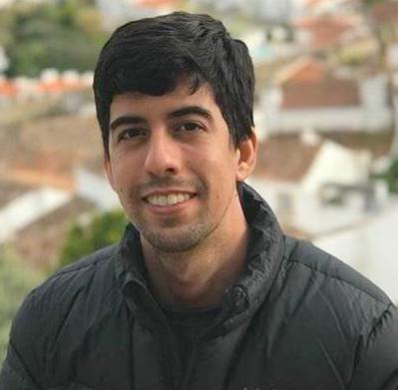
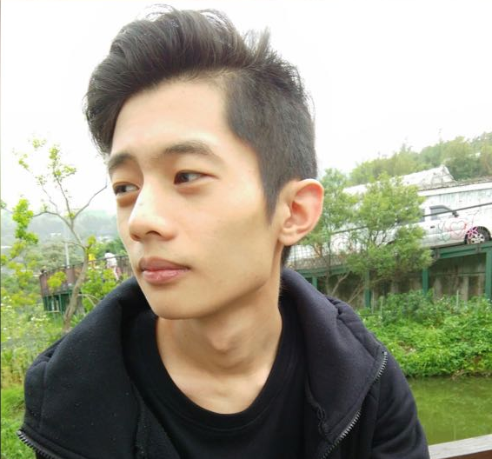
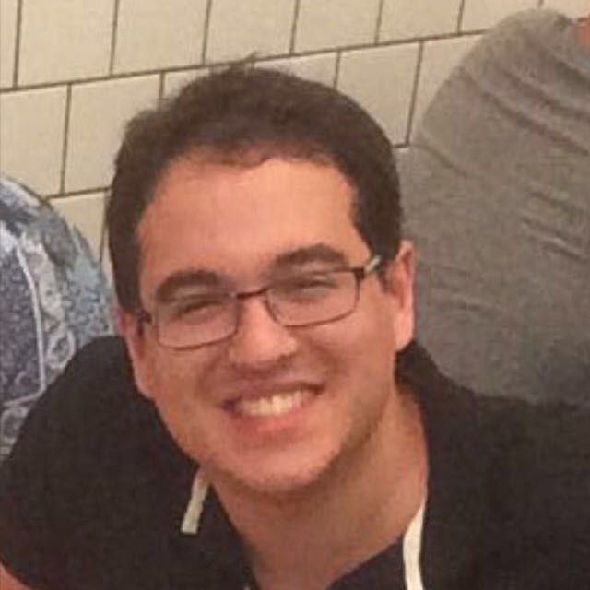
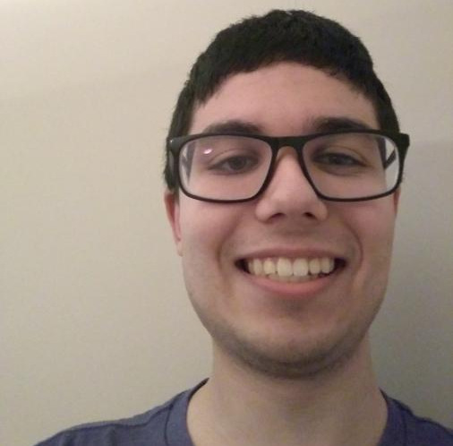
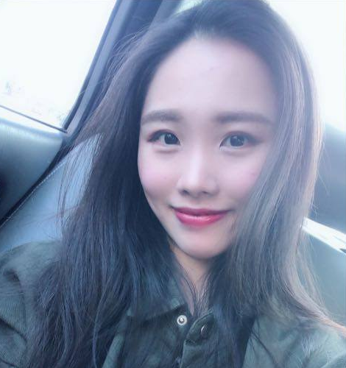
Management Team
Arthur
President/Founder
Po-shao Chen
Project Manager
Guilherme
Marketing Manager
Nicholas
IT Manager
Hsiao-Hsuan
Finance Manager

Slide 5


Key Stakeholders
Online Business
Small Companies - Startups
Social Media Advertisers

Slide 6
Structure and Ownership
President
Project Manager
IT Manager
Finance Manager
Marketing Manager
Software Developers
Web Developers
Accountants
Customer Service
Social Media ads

Slide 7
Our Location
Located in North York.
Close to Antoine's landscaping company
There are also many newly created and growing companies in this area making it a perfect area for our business.

Slide 8
Products and Services
The EPIC Digital Master Management Software
Counseling
Customized Software Solutions

Slide 9

Target Market
The main target market are small privately owned companies
- Such as Antoine's Landscaping.
New and growing companies
Online businesses

Slide 10


Competitive Advantage
We are a full team
5 fully qualified managers that work very hard and work effectively as a team
Location
Organized
Multicultural
Friendly
Flexible

Slide 11
Objective and Goals
Our objective is to grow together with our clients.
We will perform extensive research on every specific problem we are faced with and solve it accordingly.
We will become number 1 in software development company by delivering digital solutions that embrace quality problem solving
Quality is our First Priority

Slide 12
Product Positioning
The Product Position Statement For Project Management
For | Antoine's Landscape Company
Who | Requires effective control on: - time - potential clients - finances
The | The EPIC digital master management software
That | Allows the company to: - manage expenses - contact customers - direct future projects with ease and efficiency
Unlike | - possible mistakes in finance department - manually keeping track of service requests - attempting to remember an overwhelming amount of client's needs
Our Product | Automates tasks allowing for the business to run more efficiently

Slide 13




THANK YOU
EPIC Inc. - since 1995

